Slide 1
UNIT: FT-6
Proposing an Alternate
Route

Slide 2
Proposing an Alternate Route (FT-6)| Overview
NHVR’s Journey Planner routing tool has been disabled and now all cases will utilise the in-built mapping tool within the Portal. Features like ‘Drag n Drop’ functionality have been added to make it easier to update the route.
There are a range of tools available to assist you in your assessment (network layers, Google Street View, Print, Measure - Draw, Opacity Toggles, Road List)
Each Road Manager is identified in the route as a different colour (this is randomly assigned upon each login)
The functionality allows a user to update a route and save it as an alternate
  A user may save as many alternates to a route as they would like
  Each time an alternate is saved the system registers who updated the route
  There can only be one ‘current’ route on a case at a time (*this is the route you perform your assessment against)

Slide 3
Proposing an Alternate Route (FT-6)| Scenario
Scenario:
You have begun your assessment of a case and now need to check the route, you identify a better alternate route for the applicant.
Steps:
Part A
Login to the Portal
Navigate to the Case Tracker and Open the Case
Navigate to the ‘Route management’ tab
Drag and drop a section of the route to use alternate roads
On the ‘Plan’ sub tab click on the ‘Save Alt’ button to save the route
Expected Outcome:
You successfully plot & save an alternate route.
The following slide includes a video, demonstrating the scenarios and steps.

Slide 4
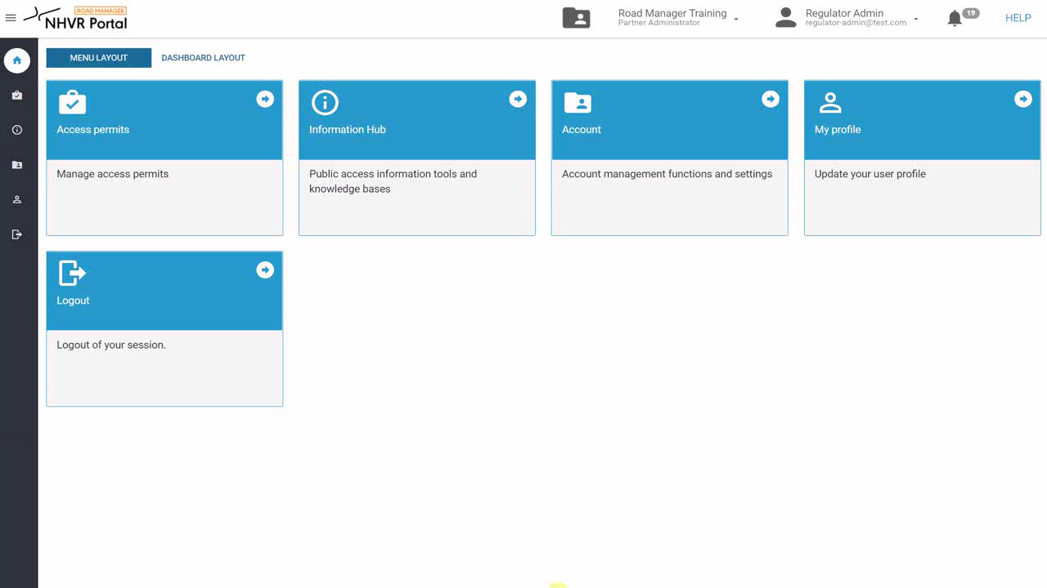
Proposing an Alternate Route (FT-6)| Video
Demonstration of previous scenario- Create an alternate route
Click here to play the video

