Slide 1
UNIT: FT-4
Using Tables & Tabs

Slide 2
Using Tables & Tabs (FT-4) | Overview
All of the tables throughout the Portal consist of the same functionality.
Tables can be filtered and sorted accordingly by the user.
There are 3 levels of tabs available within the portal:
  System – Set by the system
  Account – Created by the Administrators of the account
  Personal – Created by the user
Tables can be exported into csv data files
Up to 50 additional tabs can be added to a table

Slide 3
Using Tables & Tabs (FT-4) | Scenario
Scenario:
You have just started to use the Portal and would like to configure your Case Tracker to suit your needs.
Steps:
Login to the Portal
Navigate to the Case Tracker
Click on the ‘Add Tab’ button
Enter the name of your tab
Select the appropriate columns from the column selector and click on the ‘Apply’ button
Once the new tab has been created, view the tab, click on ‘Tab Options’ and select ‘Change columns’
Update the column order by dragging the columns into the desired order
Update the column widths for a number of columns using the ‘Width’ tool
Select a number of new columns to be displayed from the Column Selector’ tab and click ‘Apply’
EXTENSION:
Once the new tab has been created, view the tab, click on ‘Tab Options’ and select ‘Save as account level tab’
This will share the tab across all users who are on the account.
Expected Outcome:
You successfully create a personal tab and then are able to update the tab to add additional columns, re-order the columns and adjust the column widths.
The following slide includes a video, demonstrating the scenarios and steps.

Slide 4
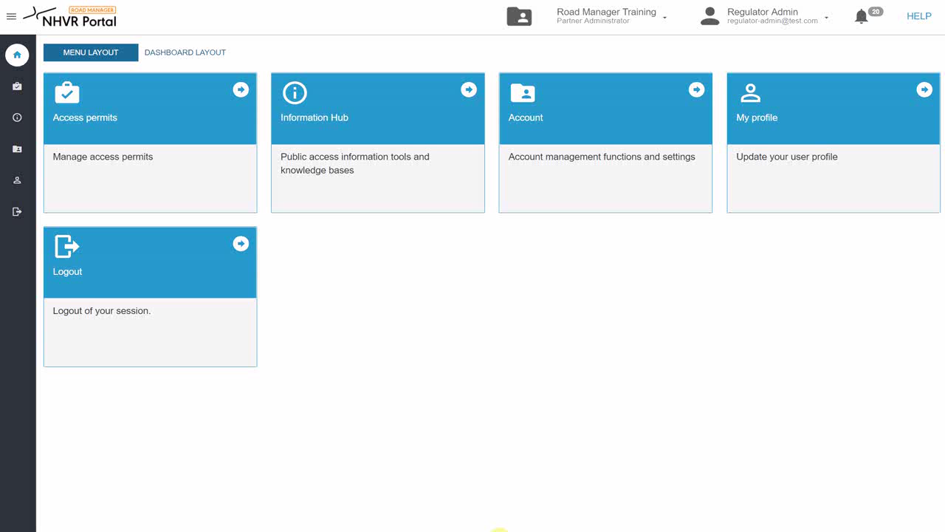
Using Tables & Tabs (FT-4) | Video
Demonstration of previous scenario- How to create a tab, add and change columns
Click here to play the video

