Slide 1
UNIT: FT-3
Managing User & Account
Information

Slide 2
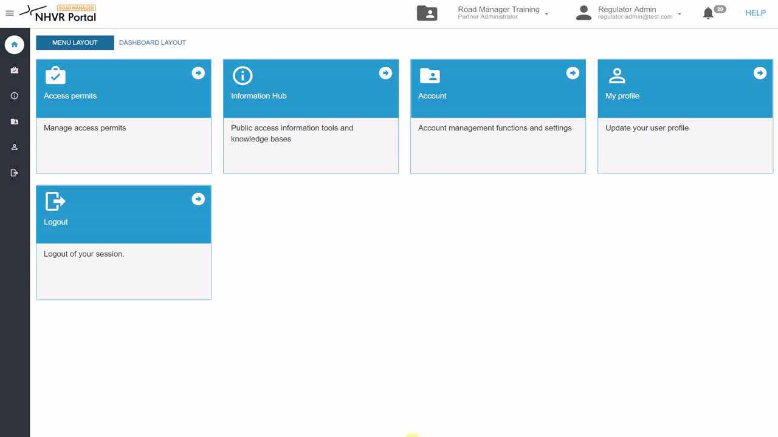
Managing User & Account Information (FT-3) | Video
Click here to play the video

