Slide 1
UNIT: FT-2
Setting up your account

Slide 2
Setting up your account (FT-2)| Overview
Each organisation has an account with a minimum of one user this user must be an Administrator. It is recommended there be two Administrators.
  Users are uniquely identified in the Portal by their email address.
Users are separate to accounts; accounts are the organisation or entity; users are an individual.
Users are considered ‘members of accounts’.
Administrators are the only ones who can configure workgroups and flags for the account, invite new users and update their permissions.
Users can have one of the following user permissions: Administrator, User (Supervisor), User (General) and User (Read Only).

Slide 3
Setting up your account (FT-2)| | User types & levels
Permission Level (Highest to Lowest) | Role Description
Administrator | This should be the user who will be responsible for inviting new users and updating permission levels Specifically this role allows users to invite new members to the account, update user permissions, deactivate users from the account, perform account setups (workgroups, flags and default tabs) It is encourage that each account has at least 2 administrator users Users have the ability to perform all functions within the portal
User (supervisor) | This role should be reserved for those who are allowed to submit a consent decision on behalf of the organisation In terms of the difference between this user permission and the User (General) role is it allows users to submit consent decisions (i.e., Approve or refuse a consent request) This permission can perform all case activities (create tasks, add notes, update the route, etc.) but cannot perform any account configurations (setting up workgroups, flags, default tabs, inviting users and updating their permissions)
User (general) | The permission allows users to complete all case functions except for submitting consent decisions They may create a decision and save it as a draft but the system will never allow the user to submit a decision The setup of this permission allows some Road Managers to continue their approval process prior to submitting any consent decisions (i.e., requiring a supervisor or manager to sign off on the consent before issuing the response) Cannot perform any account configurations (setting up workgroups, flags, default tabs, inviting users and updating their permissions)
User (read only) | Reserved for those users who will not be performing any actions within the portal other than viewing cases and reports Usually CEO’s and Executives are given this role, it allows them to view the organisations performance but cannot accidentally update anything in the portal

Slide 4
Setting up your account (FT-2)| Scenario
Scenario:
You are responsible for setting up the account in the portal for ‘Go Live’, your organisation will be using workgroups and flags as part of the processing of consents. There is a new team member who is not yet in the portal, you will need to invite them.
*Administrator User level
Steps:
Login to the Portal
Navigate to Account Management
Scroll down to the Workgroups and Flags section and add the appropriate workgroup and flag definitions
Once you have finished adding the required items, click on the ‘Save’ button
Navigate to the ‘Users’ tab and click on the ‘Add New User’ button
Complete the required fields and click on the ‘Add partner account membership’ button
Expected Outcome:
You successfully create the required workgroups and flags, and invite the new user to the account.
The following slide includes a video, demonstrating the scenarios and steps.

Slide 5
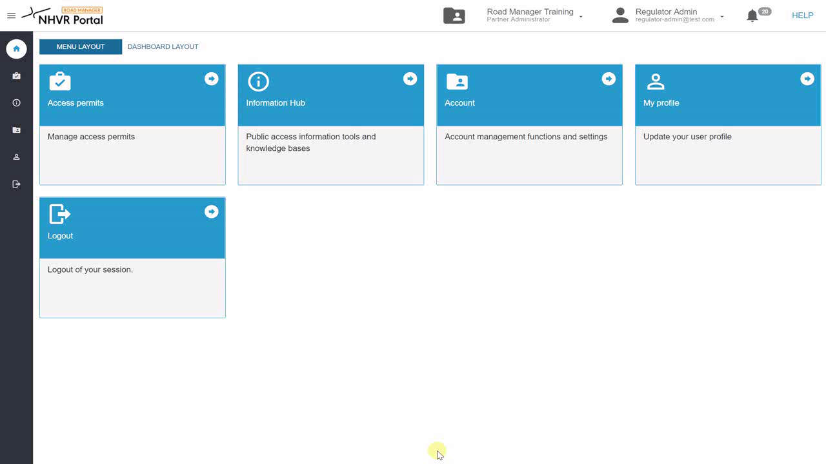
Setting up your account (FT-2)| Video
Demonstration of previous scenario- How to invite a new user, add workgroups and flags
Click here to play the video

