Slide 1
UNIT: FT-1 General navigation

Slide 2
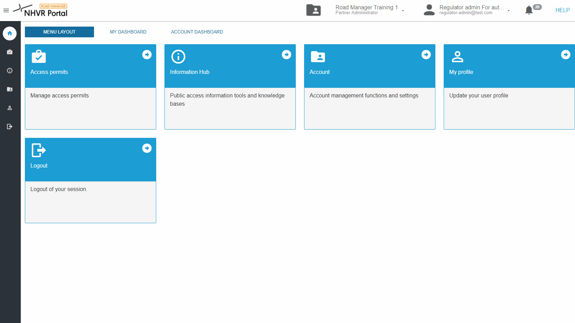
General navigation (FT-1) | Video

