Slide 1
NHVR Portal Advanced Training
Module Two – Tables and Reporting
Version 1
27th October 2017

Slide 2
Purpose of this Training
Training Purpose
Module Outline
To provide you with an understanding of the tables and reporting functions within the NHVR Portal.
Also provide an opportunity to see how the functionality works through key examples.
Pre-requisites
Overview
Examples and Practice
Assessment (as required)
Next Steps

Slide 3
Pre-requisites
Understand the Access consent request and associated processes from a Road Manager perspective.
Have an awareness of the NHVR Portal – Road Manager Module Full Solution. (YourSay site)
Have a general understanding and working knowledge of the Heavy Vehicle National Law (HVNL) and the Regulatory process for obtaining a Heavy Vehicle Access Permit.
Completed the NHVR Portal – Road Manager Module Foundation Training.

Slide 4
Learning Outcomes
At the end of this session participants will be able to:
Update an account level tab and prevent users from personalising it
Understand the export capabilities within a table
Describe how you can remove all filters from a table, revert to an account tab and remove a tab
Explain what the Dashboard report can be used for
View & Save a reporting chart as an image
Perform second level filtering on reporting chart tables

Slide 5
Tables and Reporting Solution Overview
Part 1

Slide 6
Part 1| Solution Overview
TABLES
All of the tables throughout the portal have tabs that are pre-configured by the system.
In addition to the pre-configured tabs, a user can created additional tabs to support their business requirements.
In some tables users have the ability to perform a number of actions on the records from the table (e.g., updating assignee, allocating workgroups, etc.)
Information can be exported from tables into a .csv data file, this is limited and provides two options:
Current View – Exports the current tabs columns and records displayed (2-50 rows)
10,000 Rows – Exports all columns available in the table and up to 10,000 records
When customising your table you can add as many columns as you like, the table will simply introduce a horizontal scroll bar that you can use to view the columns that do not fit within the view.
The filtering functionality differs from column to column depending on the type of value that column holds (e.g., the due date column can be filtered to show everything due in the next 7 days whereas the workgroup column is filtered by the list of workgroups configured within the account).
There is no limit to the number of tabs a table can have, the tabs section will display a horizontal scroll bar when there are too many tabs to fit on the screen.

Slide 7
Part 1| Solution Overview
Simple Overview
TABLES
LEVEL 1 SYSTEM TAB
LEVEL 2 ACCOUNT TAB
LEVEL 3 PERSONAL TAB
SET BY: System
UPDATES: None
AVAILABILITY: All Users
SET BY: Administrator
UPDATES: Limited AVAILABILITY: Account Users
SET BY: Any User
UPDATES: Yes
AVAILABILITY: Individual User
System Level Tab
Users have the ability to apply additional filters to these tabs and build additional personal tabs from these but cannot remove them.
These tabs are displayed to all users of the NHVR Portal and cannot be removed.
Account Level Tab
Only account administrator users can create tabs and set them as account level tabs.
These tabs are only available to the users within the account and cannot be removed by anyone but an administrator.
Users within the account can personalise these tabs, unless locked by the administrator.
Personal Level Tab
Any user can create a personal tab.
These tabs are only available to the user who created the tab.

Slide 8
Part 1| Solution Overview
REPORTING
There are 3 types of reporting available within the Portal:
Table Export – Adhoc reporting performed by the user
Dashboard – Live reporting performed by the system
Reporting Charts – Nightly reports performed by the system
All of the reporting is specific to the account the user is viewing the report from.
The reports are highly configurable and can represent information in numerous ways (e.g., pie graphs, stacked bar graphs, etc.)
Reports can be:
Saved as new tabs, this allows the user to set the report up once and then not have to configure it again
Exported into a csv. data file, mimicking the functionality available in the standard tables throughout the portal
Copied or Saved as an image, so it can be inserted into any reporting documentation or reports required by the business
Reports are a table with the additional functionality of displaying the records in a graph like format, this provides the ability to perform additional 2nd tier reporting filters when analysing the data displayed. The table essentially has a ‘Chart Mode’ feature that displays the data in a graph format, the reporting tables default view is the ‘Chart Mode’ but users can switch to the ‘Table Mode’ if required.

Slide 9
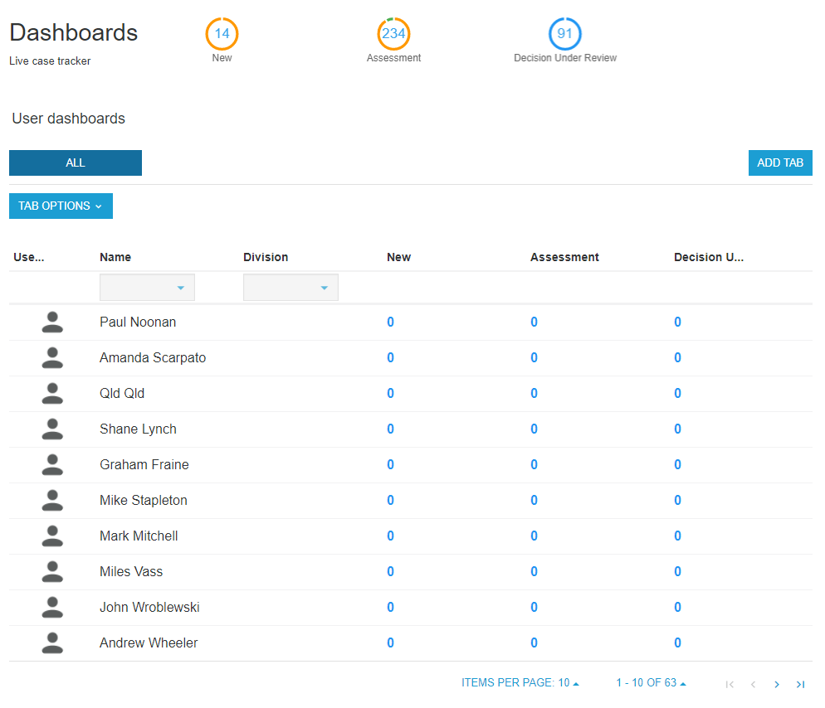
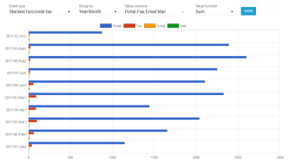
Part 1| Solution Overview
Simple Overview
REPORTING
TABLE EXPORT
DASHBOARD
REPORTING CHARTS
Table Export
Users have the ability to export a csv. file from any table within the portal.
This is limited to 10,000 records and provides the flexibility of showing only the columns selected in the current tab or all columns available for the table in the .csv output.
Dashboard
Provides a live view of the number of current cases each user in the account is processing in each workflow status.
Can be filtered to show a subset of users within the account.
Tabs can be created alike a table to save dashboard views.
Reporting Charts
Numerous charts providing a visual depiction of particular values within the NHVR Portal specific to the account.
Filterable using the table functionality and additional chart grouping filters.
Selection of charts to select from and ability to copy or save the chart as a picture.
Tabs can also be created alike a table to save chart views.

Slide 10
Part 1| Solution Overview
Detailed Overview
The following link will direct you to the detailed information of the functionality in the Help Centre. (https://help.nhvr.gov.au/support)
This information is easily accessible from within the Portal and can be accessed at any point in time.
With the frequent enhancements of the Portal the Support Material will be updated alongside any changes.

