Slide 1
Portal TV
NHVR Portal Customer Module Webinar
20 December 2017
9:30am-10:00am AEST
How to follow the progress
of an application from
start to finish

Slide 2
Introduction
Panel Members
Sean Tansley
Callum Fraser
Webinar Format
Slides
Ask questions – right side panel, type and submit, include name and organisation
‘QnA’ session at end
Viewing on tablet or mobile device – won’t be able to ask questions, send to accessconnect@nhvr.gov.au
Video of webinar and questions will be uploaded to YouTube and the Help Centre

Slide 3
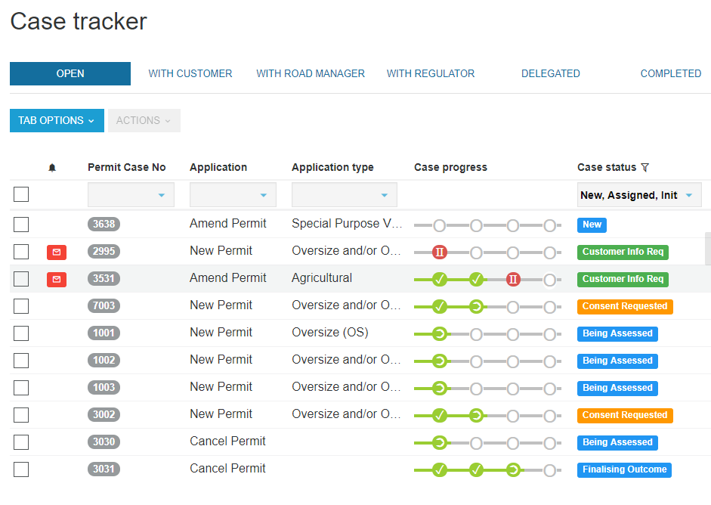
Purpose of Webinar | Case Status
The purpose of today’s webinar is to look specifically at case statuses so you can understand the progress of your permit application in the NHVR Portal.
There are 18 different case statuses, depending on the information or actions required to process a permit application.
Today, the Top 3 most common workflows and the related Case Statuses will be discussed. We will also briefly review the Consent Statuses.
We will also look at 10 reasons a case may be closed.

Slide 4
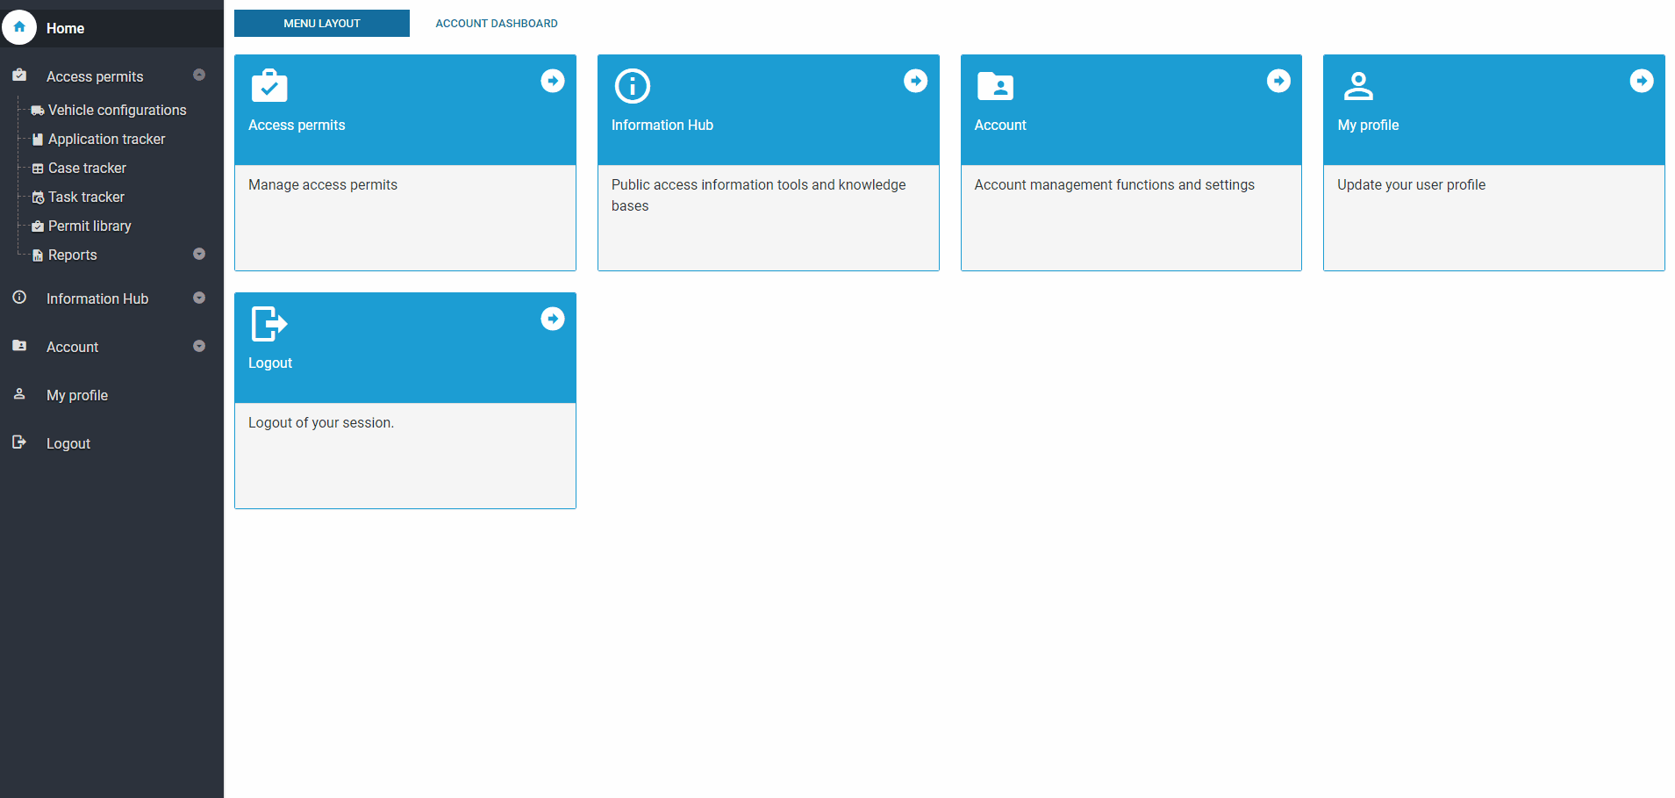
Purpose of Webinar | Case Progress
The purpose of today’s webinar is to provide you with an understanding of the case statuses your permit application moves through as it is processed in the NHVR Portal.
There are 18 different case statuses, depending on the information or actions required to process a permit application.
Today, the Top 3 most common workflows and the related Case Status will be discussed.
We will also look at 10 reasons a case may be closed.

Slide 5
Case Status | Overview
Customer Info Req’d
Consent Requested
New
Being Assessed
Assigned
Finalising outcome
Completed
Application refused
Delegated
Closed – Migrate to Permit
Closed – Duplicate
Closed – Withdrawn
Closed – Other
Closed – Non-Responsive
Closed – Expired Decision
Closed – Under Notice
Closed – In Principle
Closed - Superseded

Slide 6
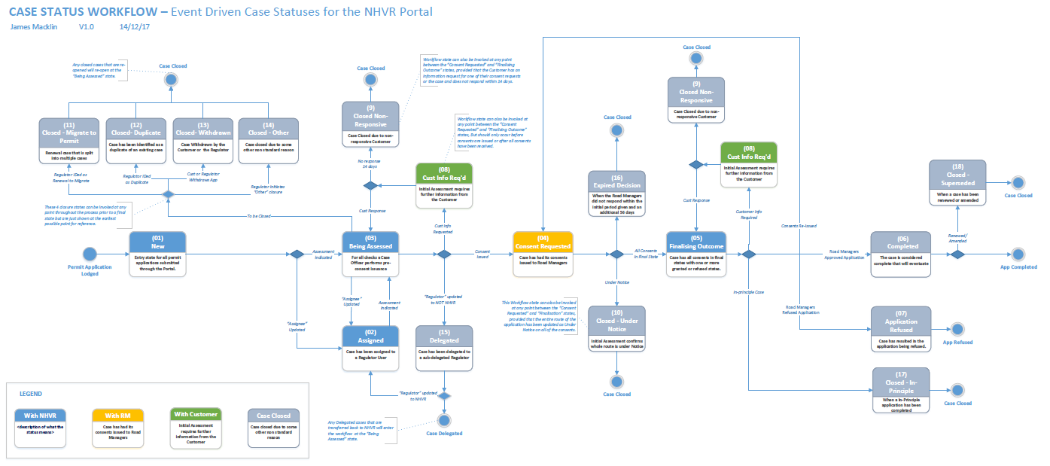
Case Status | All Workflows
View the detailed workflow and see the status descriptions on the Help Centre:
Help Centre > Case Status > Case Status & Workflows
https://help.nhvr.gov.au/online-permit-system-4/help-centre-customer/case-tracker/case-status-workflows

Slide 7
Case Status | Top 3 Most Common Workflows
Workflow 1
Additional information is not required:
Permit Application
New
Being Assessed
Consent Requested
Finalising Outcome
Completed
LEGEND
With Customer
With RM
With NHVR
Case Closed

Slide 8
Case Status | Top 3 Most Common Workflows
Workflow 2 – Type 1
Additional information is required from the Customer:
Permit Application
New
Being Assessed
Consent Requested
Finalising Outcome
Completed
Cust Info Req’d
LEGEND
With Customer
With RM
With NHVR
Case Closed

Slide 9
Case Status | Top 3 Most Common Workflows
Workflow 2 – Type 2
Additional information is required from the Customer:
Permit Application
New
Being Assessed
Consent Requested
Finalising Outcome
Completed
Cust Info Req’d
LEGEND
With Customer
With RM
With NHVR
Case Closed

Slide 10
Case Status | Top 3 Most Common Workflows
Workflow 3
Additional information is required from the Road Manager:
Permit Application
New
Being Assessed
Consent Requested
Finalising Outcome
Completed
Consent Statuses
Consent Requested 1
Cust Info Req’d
Consent Requested 2
Assessment
LEGEND
Consent Requested 3
Response Rec’d – Under review
With Customer
With RM
With NHVR
Case Closed

Slide 11
Consent Status | Overview
customer@nhvr.gov.au
ROAD MANAGER 1
ROAD MANAGER 2
With Customer
With RM
With NHVR
Closed/ Finalised
Customer Info Req’d
New
Assigned
Assessment
Overdue decision
Consent Extended
Response Rec’d
– Under Review
Granted – Notice
Granted – Pre-app
Granted with Cons
Refused
Granted
Closed – Duplicate*
Closed – Withdrawn*
Closed – Other*
Closed – Non-Responsive*

Slide 12
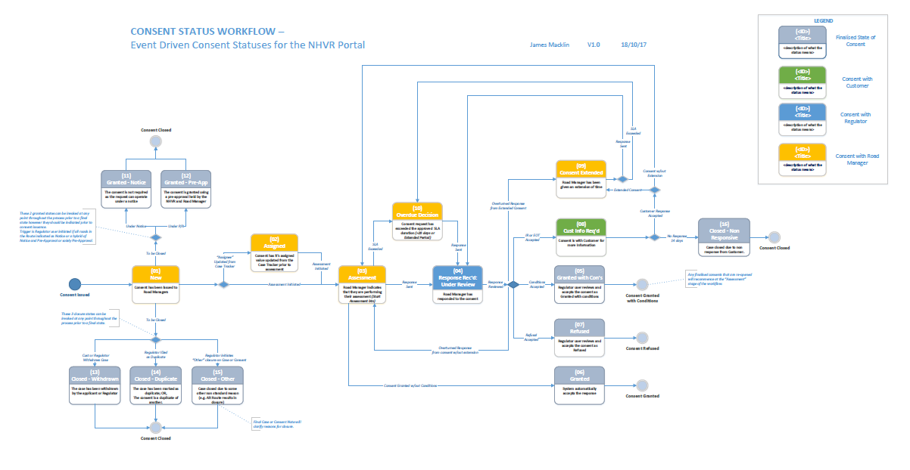
Consent Status | All Workflows
View the detailed workflow and see the status descriptions on the Help Centre:
Help Centre > Case Status > Case Status & Workflows
https://help.nhvr.gov.au/online-permit-system-4/help-centre-customer/case-tracker/case-status-workflows

Slide 13
Case Status| Closed Status Explained
Case Closed
Case Status | Reason
Closed – Migrate to Permit | Renewal case that is split into multiple cases
Closed – Duplicate | Case has been identified as a duplicate of an existing case
Closed – Withdrawn | Case withdrawn by the Customer or Regulator
Closed – Other | Case closed due to some other reason (see Case Notes for details)
Closed – Non-Responsive | Case closed due to non-responsive customer (No response for 14 days)
Closed – Expired Decision | When the Road Manager did not respond during the initial period and an additional 56 days
Closed – Under Notice | Initial assessment confirms the whole route is under notice
Closed – In Principle | When an in-principle application has been completed (PBS vehicles)
Closed - Superseded | When a case has been renewed or amended

Slide 14
Consent Status| Finalised and Closed Status Explained
Finalised/ Case Closed
Case Status | Reason
Granted Notice | When consent is not required as the request can operate under notice
Granted Pre-Approval | The consent is granted using a pre-approval held by the NHVR and Road Manager
Granted with Con’s | Regulator user reviews and accepts the consent as Granted with Conditions
Refused | Regulator user reviews and accepts the consent as Refused
Granted | System automatically accepts the response
Closed – Duplicate* | Case has been identified as a duplicate of an existing case
Closed – Withdrawn* | Case withdrawn by the Customer or Regulator
Closed – Other* | Case closed due to some other reason (see Case Notes for details)
Closed – Non-Responsive* | Case closed due to non-responsive customer (No response for 14 days)

Slide 15
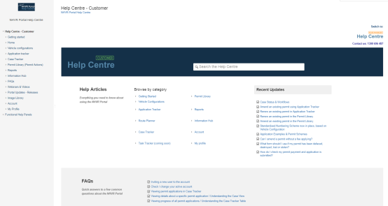
More Information| User Support
Online Support is available 24/7 via the Help Centre
Videos
FAQs
Help Articles
Past Webinars
https://help.nhvr.gov.au/support
Phone support is available via the Call Centre
Contact us on: 1300 MYNHVR (1300 696 487)
Standard 1300 call charges apply (check with your phone provider).
Hours of operation 7:00am – 5:00pm (AEST) Monday to Friday.
Closed on weekends and all national public holidays.

Slide 16
Thank you
Please get in touch
accessconnect@nhvr.gov.au
or
https://www.nhvr.gov.au/

